Slide 1
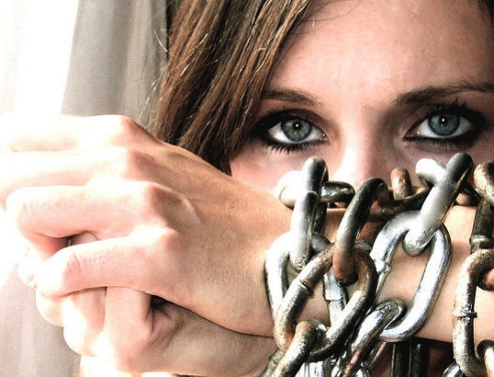
human
Trafficking is slavery

Slide 2
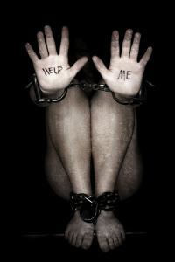
What is Human Trafficking?
A person is guilty of trafficking when:
He or she…Recruits, harbors, transports, transfers, obtain or receives by any means another person knowing that they are being forced to engage in forced labor, in voluntarily servitude, a sexually explicit act, or commercial act that financially benefits the trafficker.

Slide 3
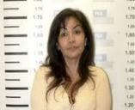
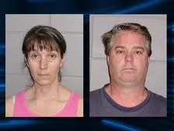
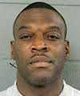
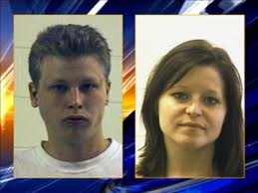
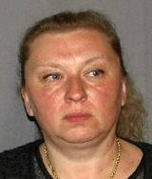
Who are Traffickers?
Female or male, young or old, citizens or foreign nationals
Stranger to victim, family member, acquaintance or an intimate partner.
Member of organized crime or gang.
Human Traffickers can be ANYONE willing to exploit another for profit
Notes:
Consolidated content from previous AAI presentations

Slide 4
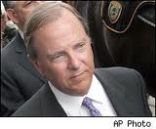
How to Spot Traffickers
May answer questions for victim
Observe victim persistently
Gives evasive answers
May not know child’s name or personal information
Poses as a relative
Notes:
Consolidated content from previous AAI presentations

Slide 5
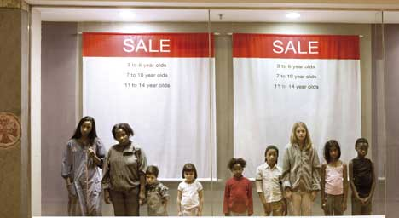
Worldwide Statistics
1.2 Million Children are Sex Trafficked Yearly

Slide 6
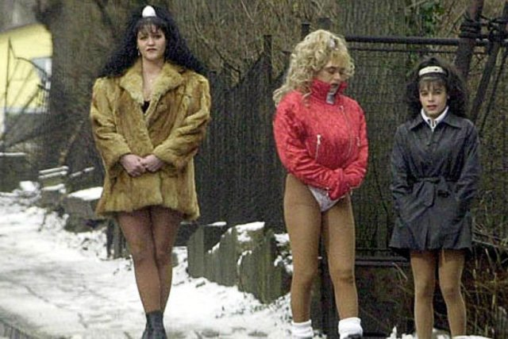
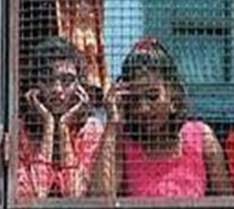
Traffickers see people as commodities…
Renewable sources of income
Often “rented” or sold to paying customers
…and exploit their vulnerabilities
Forcing or tricking people into bondage
Robbing people of their identity and travel documents

Slide 7
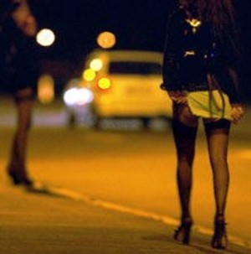
Definition of Minor
Sex Trafficking
Minor sex trafficking occurs when a person is under ____ years of age and is engaged in a commercial sex act
Commercial sex act is any sex act of
which anything of value is given to or
received by any person.
This includes:
Prostitution
Exotic Dancing/Stripping
Pornography
Sex Tourism
Survival Sex
(Definition is from the Trafficking Victims Protection Reauthorization Act (TVPRA)
18

Slide 8
International Facts
Human Trafficking generates $ 32 billion annually
Every minute, __ children are trafficked
around the world
A child can be used 20 to 30 times a day and____ days a week
In parts of the world a man can pay_____ to have sex with a 3 year-old
Department of Justice
2
20
$8,000

Slide 9
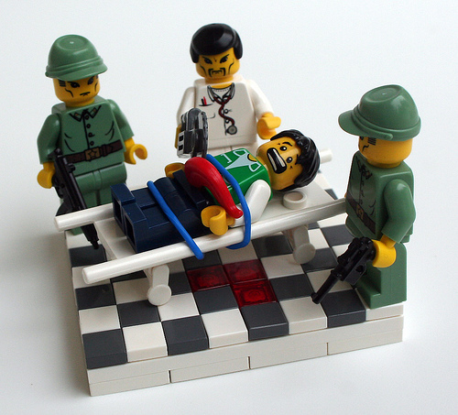
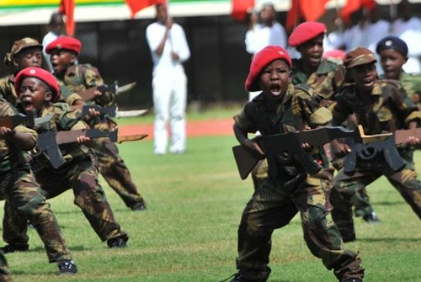
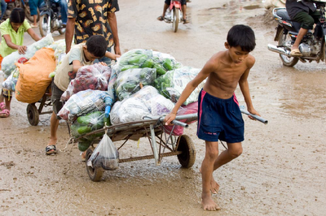
Other Types of Trafficking
Organ
Soldier
Labor

Slide 10
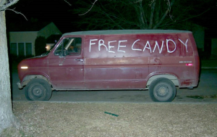
USA Statistics
National Center for Missing and Exploited Children data shows, ______children have become sexual commodities.
__ out of every __ teens on the street will be lured toward prostitution within ___hours of leaving home. This means at least ______ children are lured into
prostitution each year.
Nationally ______children
run away from home each year
250,000
1
3
48
150,000
450,000

Slide 11
USA Facts
Seattle, Portland, Las Vegas and Phoenix are in the top 10 cities for child sex trafficking - FBI Sting Operations
One quarter of all sexually victimized and trafficked children worldwide are US citizens - Department of Justice
THREE Major Circuits in the USA-Eastern, Southern, Western
1-855-646-5484 Called to Rescue Hotline
put this number in your cell phones

Slide 12
Procedure
Recruiting-Grooming
Through lures of love, affection, money, safety, protection and “family”
Pimps have a sense for girls who are vulnerable
Breaking
Multiple stages and these vary depending on the pimp’s “game”
Partying, getting hair and nails done, new clothes, street name, made to feel special
Maintaining
The point of which a girl “turns her first trick” Is being “turned out”
All girls remember how/when they were “turned out”
Maintaining happens with extreme abuse

Slide 13
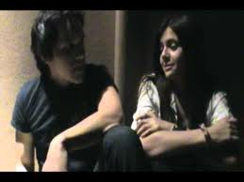
Myths
Myth: The youth knew what she was getting into
Fact: Victims are often seduced, coerced, tricked or forced into prostitution by pimps
Myth: The youth is a criminal
Fact: The youth is a victim of the crime of sex trafficking
Myth: All sex trafficked children are street children Fact: Sex trafficking happens to
children from all social
status

Slide 14
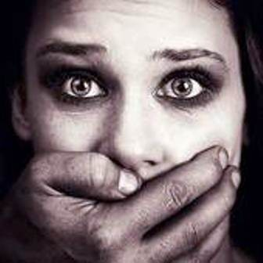
Myths
Myth: Victims trafficked within a state don’t qualify for federal victim assistance
Fact: All victims of trafficking qualify under federal law
for victim assistance
Myth: The youth has freedom of
movement
Fact: Victims are held in physical
and/or emotional bondage
and are not free to leave

Slide 15
Street Language
sex
John, Trick, Date- The names used for men who pay for ____
The Life- Term that refer to the underground world of prostitution including the _____and ____________
Track, Blade, Ho Stroll- Terms for the areas where street prostitution occurs. Generally sidewalks or corners of specific streets or intersections, malls or other public areas.
Bottom Girl (Bottom B*#*h)- Girl that the most________ with the pimp. Often was the first girl that “ _______” for him. Maybe responsible for recruiting, grooming or managing other _____
Stable- A group of _____________ under the pimps control
Chicken Farm- A group of _____ under the pimps control
rules
Expectations.
status
worked
Girls.
Women/girls
boys

Slide 16
Street Language
Out of Pocket- When a girl “breaks the rules” or does some thing that makes the pimp angry. Grounds for violence and abuse.
Daddy– Your own pimp—Invoking images of fatherhood
Choosing Up - This refers to “choosing” a new/different pimp. This is often as simple as making eye contact with a different pimp. One of the reasons girls are not allowed to make eye contact with anyone other than “dates”.
Renegade, Loose Bunny - A girl involved in (usually) street prostitution without a pimp. This is very dangerous for girls and they are often kidnapped or forced to “choose up”.
Quotas-The amount of money that a girl must make on any given night, set by the pimp. All money is turned over to the pimp this is called “Breaking a B*#*h”

Slide 17
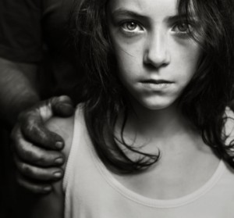
Pathway
There is a distinct correlation between early childhood sexual abuse and __________
prostitution
It is estimated that _____of youth in prostitution have a history of sexual abuse, rape or trauma
Statistics show that __ in ___ women will be raped within their lifetime and are ___ times more likely to become a prostitute later in life.
90%
1
6
26

Slide 18
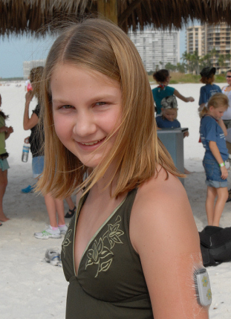
Pathway
Youths who have _____ trauma history are more vulnerable to exploitation and pimps are savvy at detecting this vulnerability.
The average age for a youth to
be targeted by traffickers for
prostitution in the US
is _____ years old.
sexual
12 to 13

Slide 19
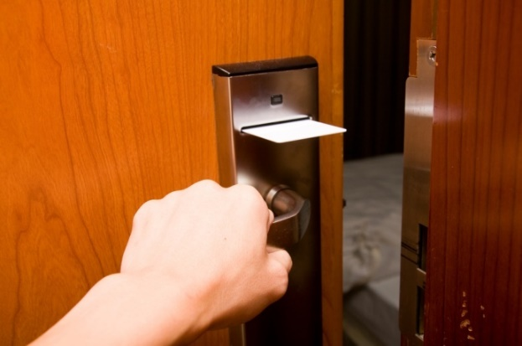
Keys Signs of Trafficking
Excess amount of cash
Hotel room keys
Chronic runaway/homeless youth
Signs of branding (tattoo, jewelry)
Lying about age/false identification

Slide 20
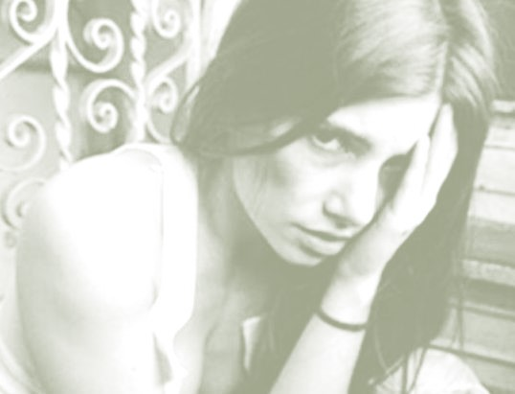
Why Don’t Victims Escape?
Don’t know their location
Moved often to avoid forming relationships and attracting attention
Told families will be harmed
Don’t know the language
Trauma Bonding -The Stockholm Syndrome
Notes:
Information from previous AAI presentations

Slide 21
Signs of a Trafficked Person
Lack of Control:
Has few or no personal possessions
Is not in control of his/her own money, no financial records, or bank account
Is not in control of his/her own identification documents (ID or passport)
Is not allowed or able to speak for themselves
Claims of just visiting and inability to clarify where he/she is staying/address/city
Loss of sense of time
Has numerous inconsistencies in his/her story

Slide 22
Signs of a Trafficked Person
Poor Mental Health or Abnormal Behavior:
Is fearful, anxious, depressed, submissive, tense, or nervous/paranoid
Exhibits unusually fearful or anxious behavior after bringing up law enforcement
Avoids eye contact
May be under the influence of drugs/alcohol from trafficker
Poor Physical Health:
Lacks health care
Appears malnourished
Shows signs of physical and/or sexual abuse, physical restraint, confinement, or torture

Slide 23
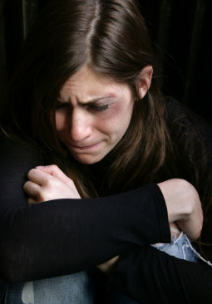
Impact on the Physical Damage
Infectious diseases Permanent scarring from cigar and cigarette burns
Internal physical damage
Unset broken bones
Malnourishment

Slide 24
Outcome
The psychological
bond between the pimp
and the victim is called
__________,also
known as Stockholm Syndrome.
The result is:
______to self-identify
Return to the _____________
_____of violence/abuse/exploitation
Trauma Bonding
Failure
Pimp/trafficker
Denial

Slide 25
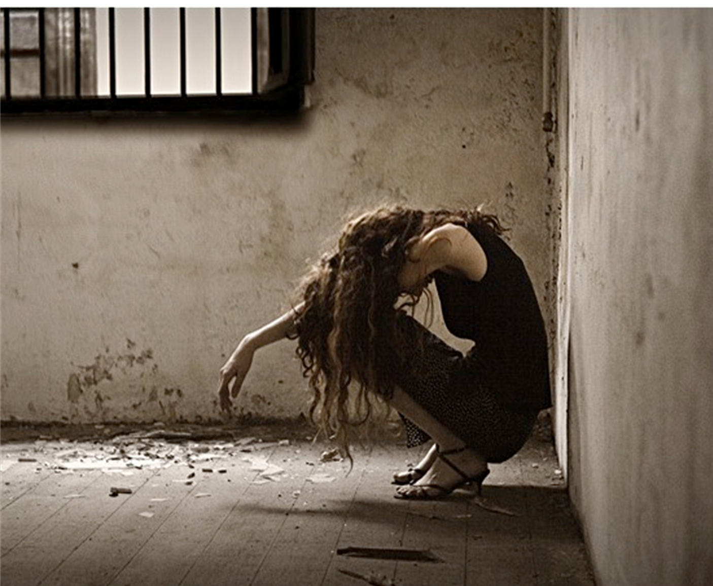
Long Term Psychological Damage
Post-Traumatic Stress Disorder
Substance abuse
Eating Disorders
Suicidal thoughts
Self-hatred
May break physical chains, but psychological chains remain for 15-20 yrs.

Slide 26
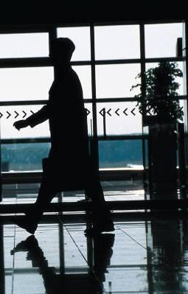
What are the indicators of a Victim?
Do NOT confront anyone you suspect of engaging in trafficking
Do NOT try to rescue any possible victim
Do NOT display any unusual concern or alarm
Do NOT endanger yourself or others
Do Call 911

Slide 27
Keeping Your Computer Safe?
Block all TV’s and computers from porn
Know what your children are doing online
Know what your children are doing on their phone
Computers and phones should charge in parents bedroom at night
Computers never used in a bedroom

Slide 28
Ways to support Called To Rescue
Like us and support us on Facebook
Join or start a Task Force in your city
Contact Prominent People and Corporations for their help and financial donations
Get the word out about Called To Rescue
Sponsor a table at our annual fundraising dinner
Paypal at www.calledtorescue.org

