Slide 1
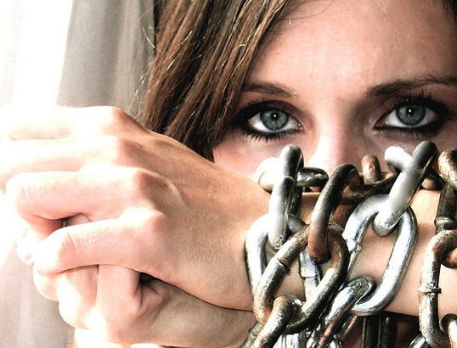
human
Trafficking is slavery

Slide 2
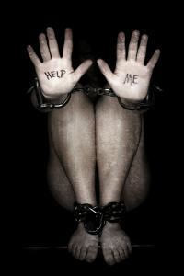
What is Human Trafficking?
A person is guilty of trafficking when:
He or she…Recruits, harbors, transports, transfers, obtain or receives by any means another person knowing that they are being forced to engage in forced labor, in voluntarily servitude, a sexually explicit act, or commercial act that financially benefits the trafficker.

Slide 3
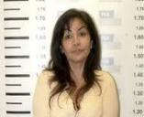
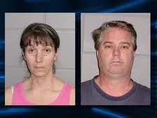
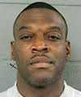
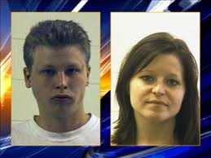
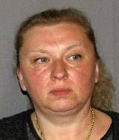
Who are Traffickers?
Female or male, young or old, citizens or foreign nationals
Stranger to victim, family member, acquaintance or an intimate partner.
Member of organized crime or gang.
Human Traffickers can be ANYONE willing to exploit another for profit
Notes:
Consolidated content from previous AAI presentations

Slide 4
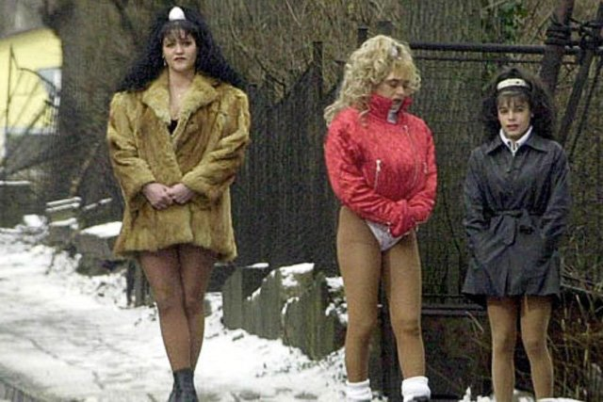
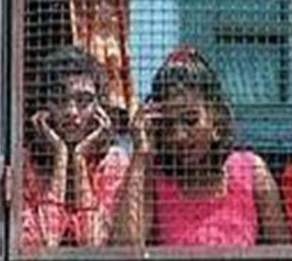
Traffickers see people as commodities…
Renewable sources of income
Often “rented” or sold to paying customers
…and exploit their vulnerabilities
Forcing or tricking people into bondage
Robbing people of their identity and travel documents

Slide 5
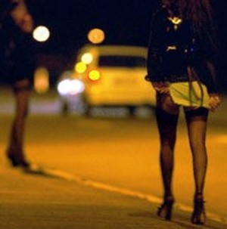
Definition of Minor
Sex Trafficking
Minor sex trafficking occurs when a person is under ____ years of age and is engaged in a commercial sex act
Commercial sex act is any sex act of
which anything of value is given to or
received by any person.
This includes:
Prostitution
Exotic Dancing/Stripping
Pornography
Sex Tourism
Survival Sex
(Definition is from the Trafficking Victims Protection Reauthorization Act (TVPRA)
18

Slide 6
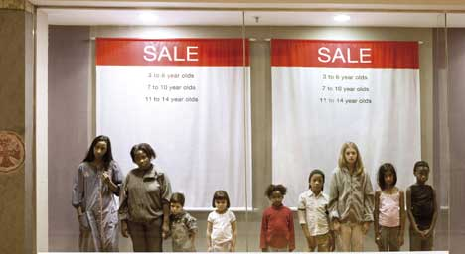
Worldwide Statistics
1.2 Million Children are Sex Trafficked Yearly

Slide 7
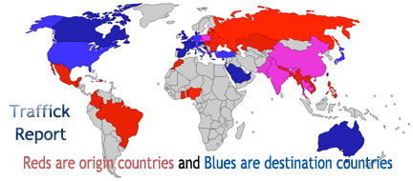
INTERNATIONAL TRAFFICK REPORT

Slide 8
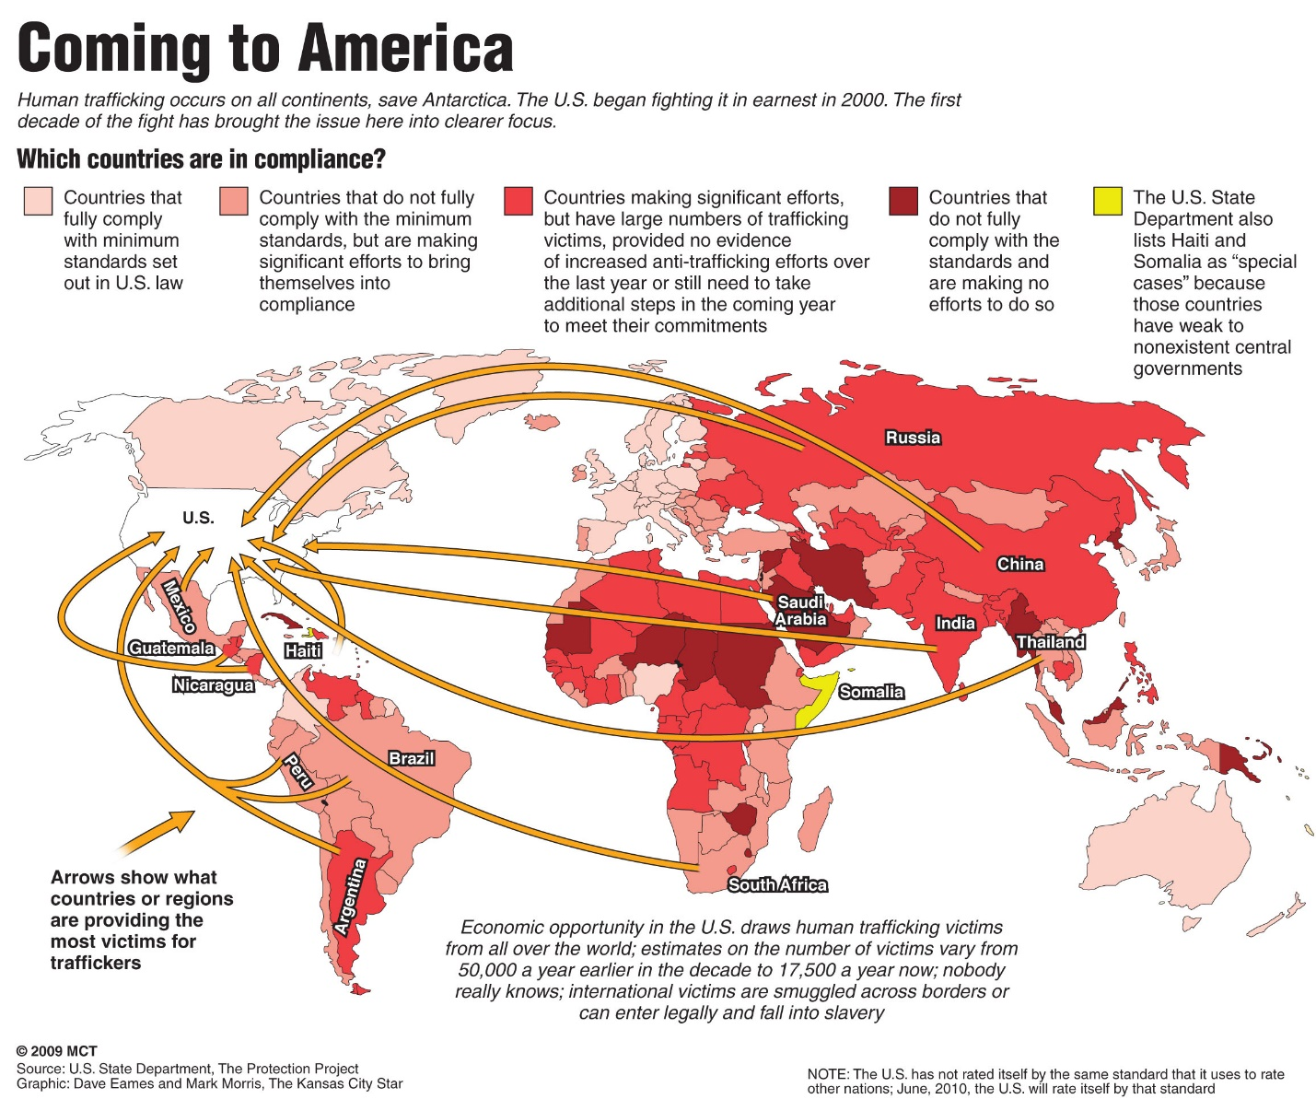
TRAFFICKED PERSONS COMING TO USA

Slide 9
International Facts
Human Trafficking generates $ 32 billion annually
Every minute, __ children are trafficked
around the world
A child can be used 20 to 30 times a day and____ days a week
In parts of the world a man can pay_____ to have sex with a 3 year-old
Department of Justice
2
20
$8,000

Slide 10
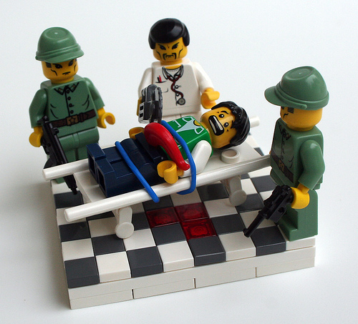
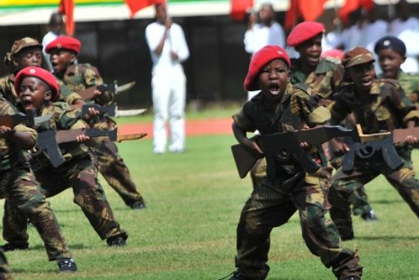
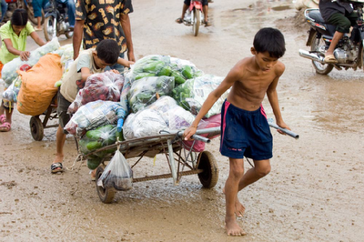
Other Types of Trafficking
Organ
Soldier
Labor

Slide 11
2014 study by International Labor Organization $150 BILLION
business!
20.9 Million Victims
Worldwide
Modern Slavery
Sex Trafficking
4.5m
14.2m
Notes:
Figures from UNICEF
11

Slide 12
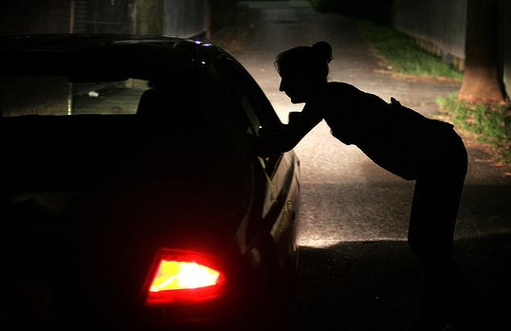
Sex Buyers
Are both Male & Female and vary in race and ethnicity.
They range in age from ___ to___.
Approximately ___ of those arrested do not speak English.
There is a positive correlation
Between sex buyers and
_____________
Sex buyers lack any empathy
towards the prostitute.
16
80
40%
Criminal Activity.

